Slide 1
Topic 24: Pulmonary
Dr. T

Slide 2
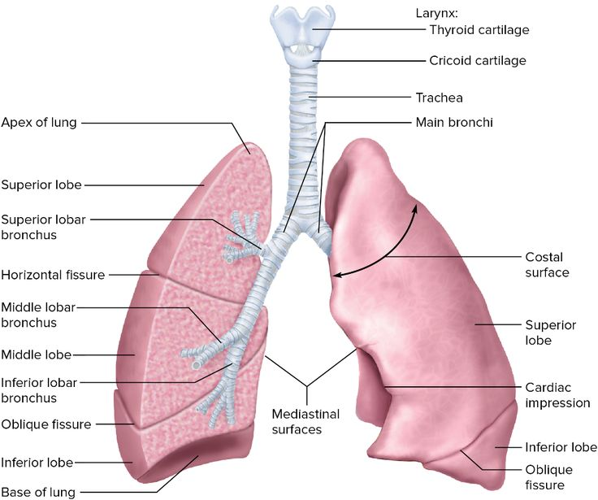
R lung: 3 lobes
L lung: 2 lobes
*d/t position of the heart

Slide 3
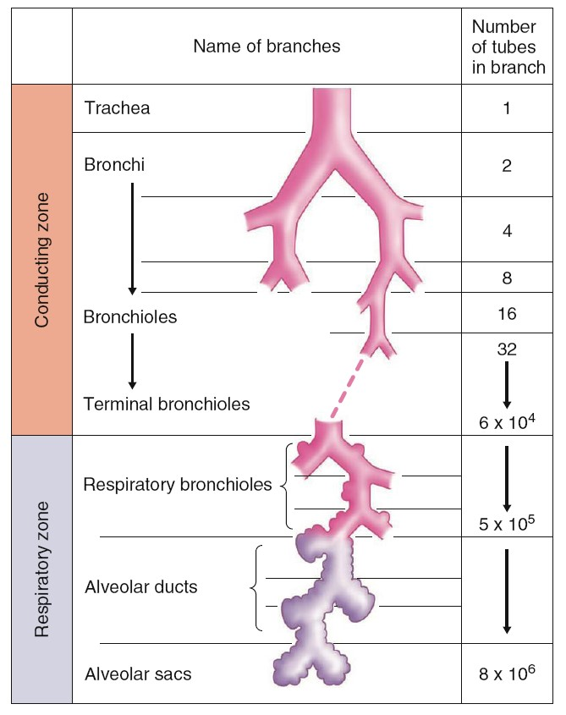
Organization of the Respiratory System
The respiratory system consists of two major functional divisions:
(1) Conducting Zone (nose → terminal bronchioles) and
(2) Respiratory Zone (respiratory bronchioles → alveoli).
Conducting zone structures provide no gas exchange; their primary roles are: air delivery, filtration, humidification, and adjustment to body temperature (warms air).
The respiratory zone contains thin-walled, highly vascularized alveoli, optimized for rapid diffusion of gases.
The structural complexity of branching airways maximizes surface area while reducing resistance to airflow.

Slide 4
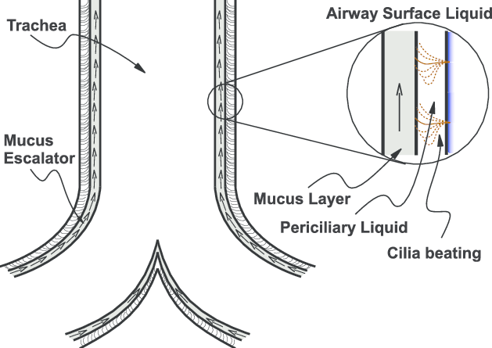
Conducting Zone Functions
Inspired air contains particulates, microorganisms, and temperature variation. The conducting zone modifies this air before it reaches delicate alveoli.
Mucociliary escalator (use of mucus and cilia to push mucus upward from bronchi toward the throat) uses coordinated ciliary movement to sweep mucus upward toward the pharynx for swallowing. Goblet cells produce mucus to capture pathogens.

Slide 5
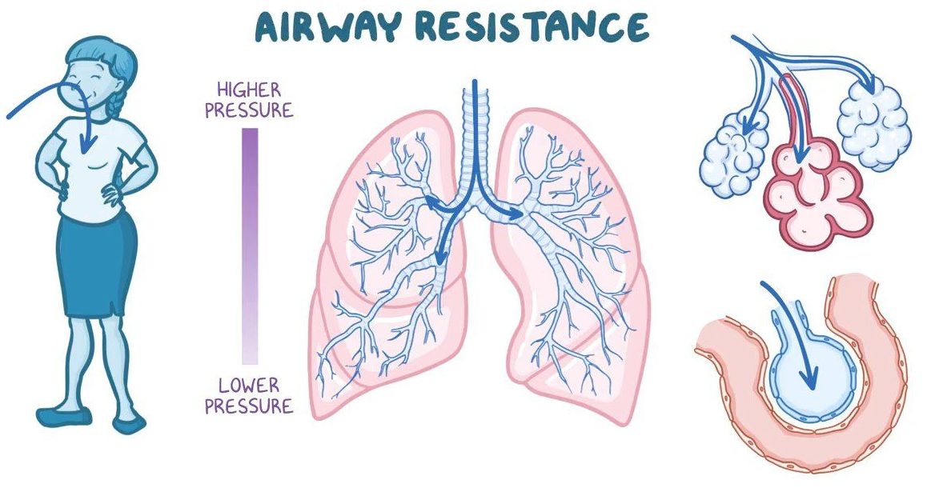
Conducting Zone Functions
Airflow resistance here is influenced by: airway diameter, mucus production, and smooth muscle tone.
1) Airway diameter (Poiseuille’s law: decrease in radius -> increases resistance)
2) Mucus production (excessive mucus can narrow airways)
3) Smooth muscle tone (hyperreactive smooth muscles constricts aggressively during irritant exposure)
Cigarette smoke, pollutants, and chronic inflammation damage cilia → impaired mucociliary clearance → chronic bronchitis and repeated infections.

Slide 6
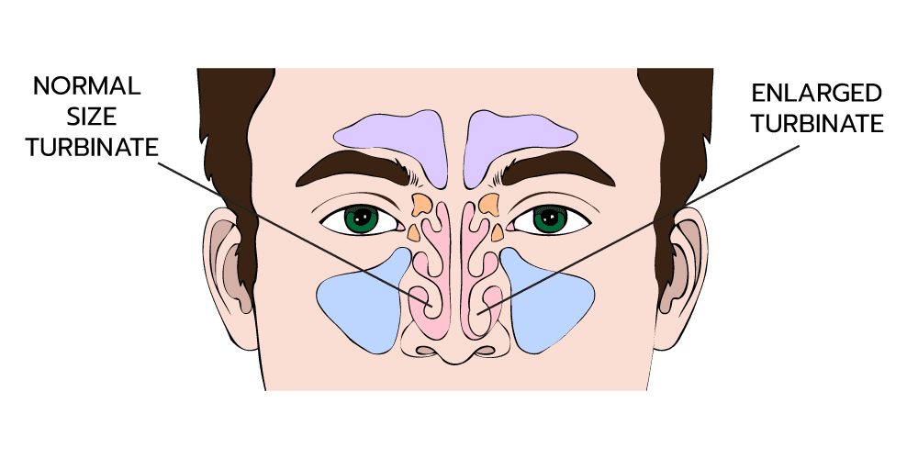
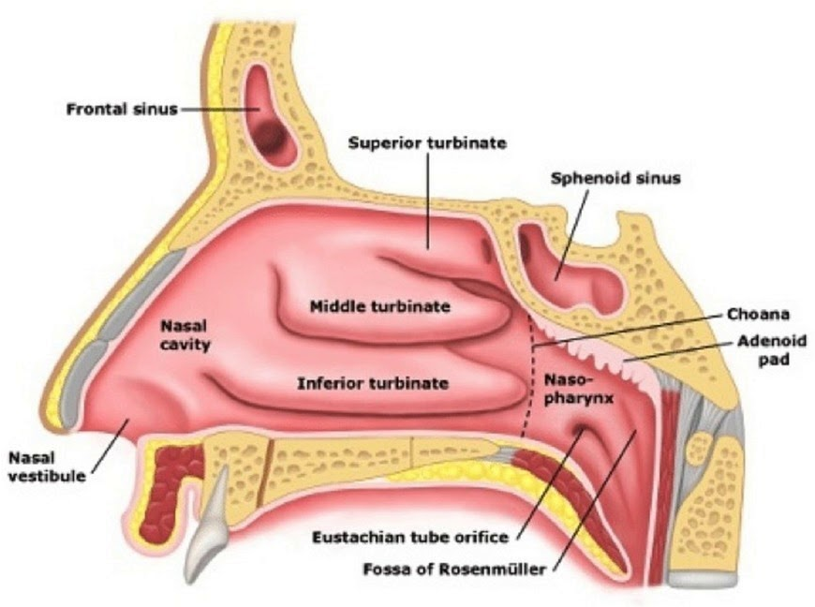
Nasal Cavity and Turbinates
The nasal turbinates (conchae) create turbulent airflow, causing particles to collide with mucus-lined surfaces.
Extensive capillary beds warm and humidify inspired air, preventing desiccation (drying out) of alveoli.
Parasympathetic stimulation dilates mucosal vessels, increasing congestion. (more blood flow/water →to mucus → swelling)
Sympathetic activation produces decongestion (pseudoephedrine)
*Overuse of topical nasal decongestants leads to rebound congestion (rhinitis medicamentosa) (mimics SNS→overuse→receptors are desensitized→dilation).
curved bony structures inside the nasal cavity
Look like waves

Slide 7
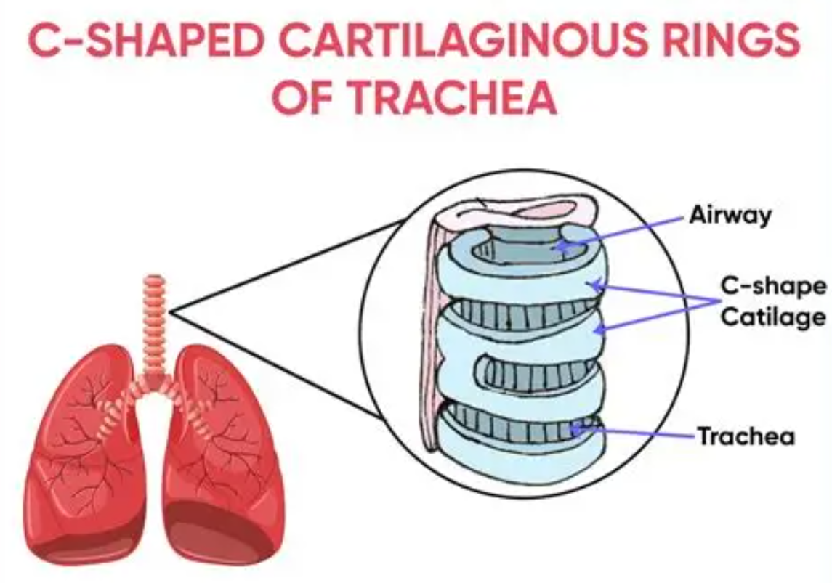
Trachea and Bronchi
The trachea contains C-shaped hyaline cartilage rings supporting airway patency (how open/unobstructed) during inhalation and exhalation.
As airways branch into bronchi and lobar bronchi, cartilage becomes discontinuous, and smooth muscle proportion increases.
Airflow velocity decreases as cross-sectional area increases.

Slide 8
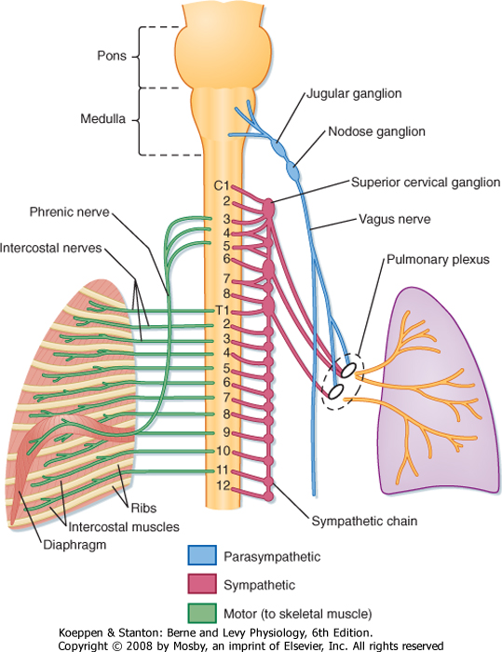
Trachea and Bronchi
β₂-AR in the lungs: Bronchodilators (albuterol)(β₂-agonists) relax smooth muscle → improved airflow in asthma.
SNS+PSNS make a plexus → innervate the smooth muscles along the bronchi and bronchioles and blood vessels

Slide 9
Bronchioles and Transition to Respiratory Zone
Beyond the terminal bronchioles, cartilage disappears → airways now depend on surrounding lung tissue (parenchymal tethering) for patency (state of being open).
Smooth muscle dominates → primary site of resistance modulation.
Airway caliber responds to CO₂ levels in local alveoli — low ventilation triggers bronchiolar constriction.
Clinical relevance: Asthma involves exaggerated smooth muscle contraction, increasing airway resistance.

Slide 10
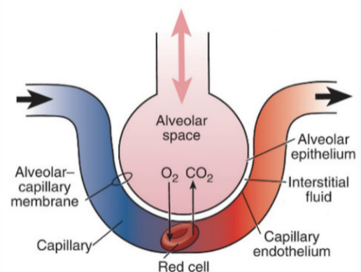
Respiratory Zone
Begins at respiratory bronchioles, continues through alveolar ducts, ending at alveolar sacs.
Each alveolus is wrapped in a dense pulmonary capillary network.
The enormous number of alveoli (~300 million) provides 70–100 m² surface area — roughly the area of a tennis court.

Slide 11
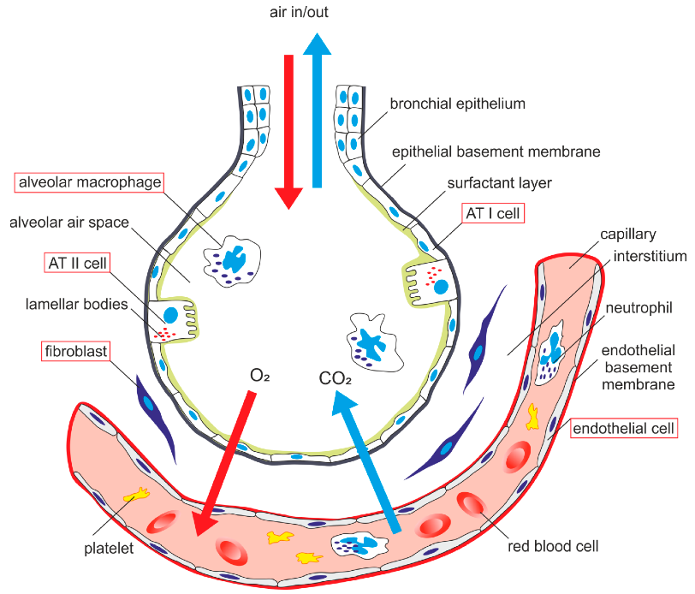
Alveolar Structure and Cell Types
Type I alveolar cells (pneumocytes): Flat epithelial cells covering >90% of alveolar surface; primary site for gas exchange.
Type II pneumocytes: Produce surfactant, a phospholipid compound that reduces surface tension.
Alveolar macrophages: Remove debris and pathogens.

Slide 12
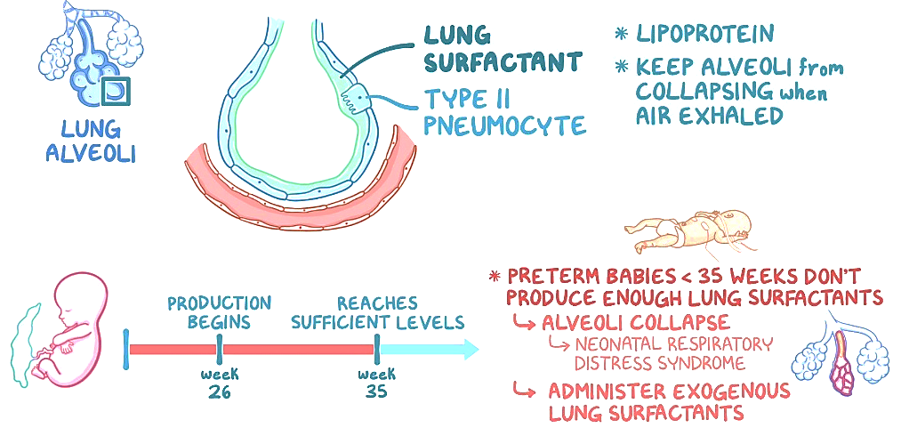
Babies, especially premature infants, may not have enough surfactant at birth. Surfactant production ramps up late in pregnancy, especially after 32–34 weeks gestation. Before that, it is often insufficient.

Slide 13
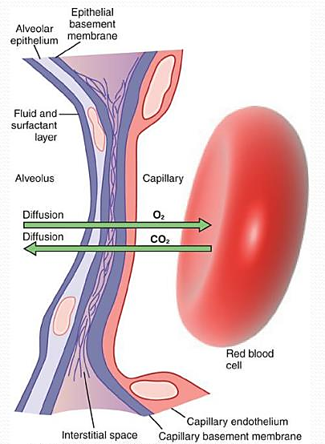
Alveolar-Capillary Barrier
This entire structure:
Extremely thin diffusion membrane: Type I cell + basement membrane + capillary endothelium.
The barrier supports rapid diffusion of O₂ and CO₂ due to:
(1) High surface area, Minimal diffusion distance, High perfusion.
(2) Any thickening (edema, fibrosis) impairs gas exchange.

Slide 14
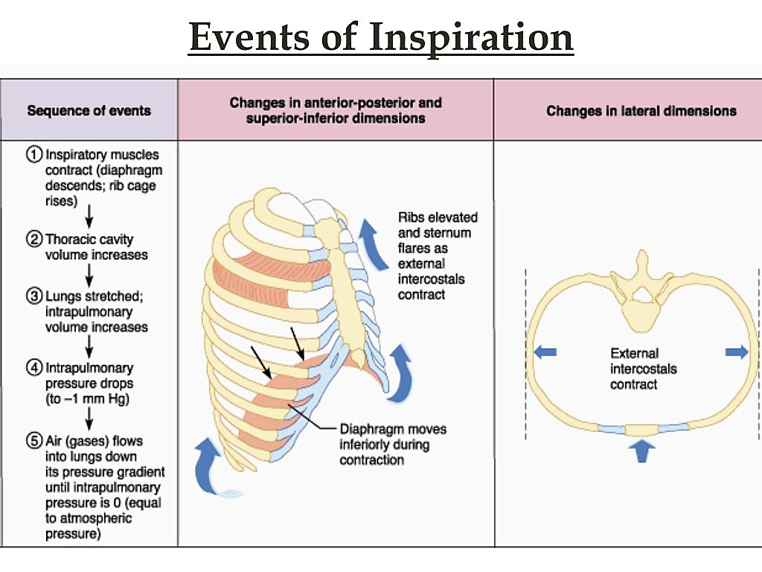
Inspiration
Quiet
1. Brain Sends Signal
The medulla oblongata (respiratory center) sends impulses via the phrenic nerve to the diaphragm.
2. Diaphragm Contracts & Moves Down
It flattens from a dome shape → increases vertical dimension of thoracic cavity.
3. External Intercostal Muscles Contract
Lift and pull ribs up and out → increases side-to-side and front-to-back chest dimensions.
4. Thoracic Cavity Volume Increases
The space inside the chest becomes bigger.

Slide 15
Inspiration
Quiet
5. Intrapulmonary (Alveolar) Pressure Drops
Boyle’s law: volume ↑ = pressure ↓
Alveolar pressure drops from 760 → ~758 mmHg
6. Air Rushes Into Lungs
Air always moves from higher pressure (outside) → lower pressure (inside lungs)
This fills alveoli with fresh air.
7. Gas Exchange Begins
Oxygen diffuses from alveoli → blood
CO₂ diffuses from blood → alveoli

Slide 16
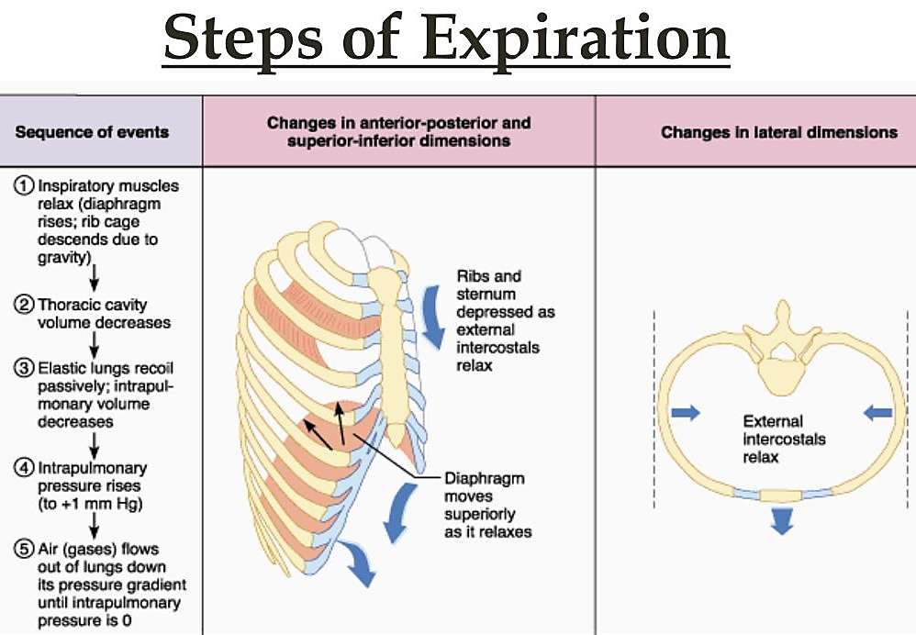
Exhalation
Quiet
1. Nervous System Stops Stimulus
The diaphragm and intercostals relax.
2. Diaphragm Moves Up
Returns to dome shape → reduces vertical chest dimension.
3. Ribs Fall Down and In
External intercostals relax → chest wall recoils.
4. Thoracic Cavity Volume Decreases
Space in the lungs becomes smaller.

Slide 17
Exhalation
Quiet
5. Intrapulmonary Pressure Rises
As volume ↓, pressure ↑ above atmospheric: ~762 mmHg
6. Air Flows Out of Lungs
Air moves from high pressure (lungs) → low pressure (outside)
7. Alveoli Remain Partially Open
Thanks to residual volume and surfactant preventing collapse.

Slide 19
Ventilation
Ventilation refers to the mechanical movement of air into and out of the lungs. For air to move, a pressure gradient must exist—air always flows from an area of higher pressure to lower pressure. The respiratory system creates these gradients by changing thoracic volume via muscle contraction.
Inspiration is an active process at rest:
The diaphragm contracts and descends, increasing thoracic cavity volume.
This expands the lungs, causing intrapulmonary (alveolar) pressure to drop below atmospheric pressure.
Air rushes in until alveolar pressure equilibrates with atmospheric pressure.
Expiration during quiet breathing is passive:
The diaphragm relaxes.
Elastic elements of the lung recoil back to their resting state.
This reduces lung volume, increasing alveolar pressure above atmospheric pressure, pushing air out.
Forced expiration (exercise, coughing, COPD) becomes active:
Internal intercostals and abdominal muscles contract.
Raises intrathoracic pressure and accelerates airflow out of the lungs.
Patients with COPD rely heavily on accessory muscles due to loss of elastic recoil, making expiration labored.

Slide 20
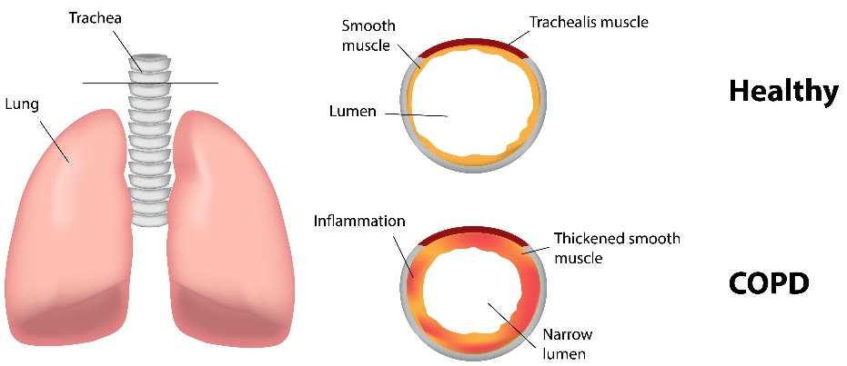
COPD = Chronic Obstructive Pulmonary Disease
COPD is a progressive, irreversible lung condition characterized by airflow obstruction that makes it difficult to exhale fully. It is a major cause of morbidity and mortality worldwide.
Chronic Airflow Limitations: Persistent abstruction due to airway narrowing and loss of elastic recoil. Air becomes trapped in the lungs → hyperinflation → difficulty breathing
Pathophysiological Changes in COPD
Loss of elastic fibers → decreased recoil → air trapping
Mucus production → obstructs airflow
Small airway inflammation → narrowing of bronchioles
Flattened diaphragm due to hyperinflation → inefficient breathing mechanics

Slide 21
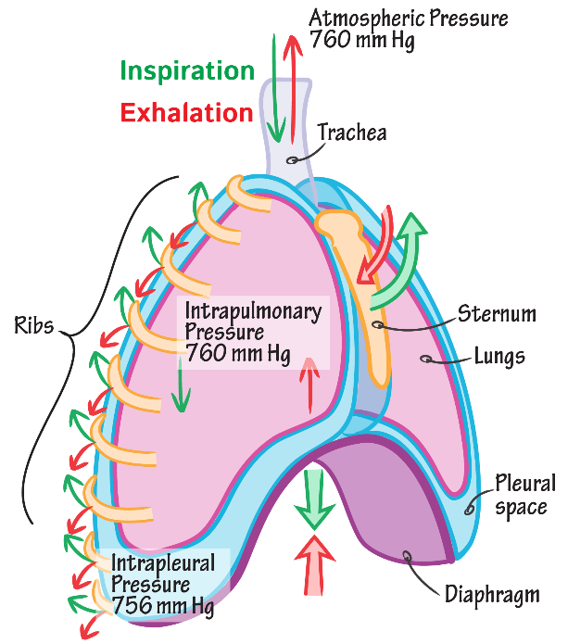
Pressure Relationships
Breathing mechanics depends on three key pressures:
(1) Atmospheric Pressure (Patm)
~760 mmHg at sea level (used as reference). (or as 0 mmHg)
Does not change during normal breathing.

Slide 22
Pressure Relationships
(2) Alveolar Pressure = Intrapulmonary Pressure (PA)
Changes with ventilation:
Slightly negative during inspiration,
Slightly positive during expiration.
Determines airflow direction.
*Changes with breathing
Inspiration: PA becomes slightly negative (about –1 mmHg) → air flows into lungs
Expiration: PA becomes slightly positive (about +1 mmHg) → air flows out of lungs
Boyle’s Law:
P1​V1​=P2​V2
↑​p → ↓v
↓p → ↑v
Notes:
P1​V1​=P2​V2​

Slide 23
Pressure Relationships
(3) Intrapleural Pressure (Ppl)
Normally negative due to opposing forces of chest wall expansion and lung recoil.
Prevents lung collapse.
Becomes more negative during inspiration as thoracic volume increases.
The pressure in the pleural cavity between the lung surface and the chest wall.
Always negative under normal conditions (~ –4 to –6 mmHg at rest)
ALWAYS A NEGATIVE PRESSURE
Lungs and chest wall opposing forces (vacuum)
Pleural fluid adhesion (wet glass slides/sticky)

Slide 24
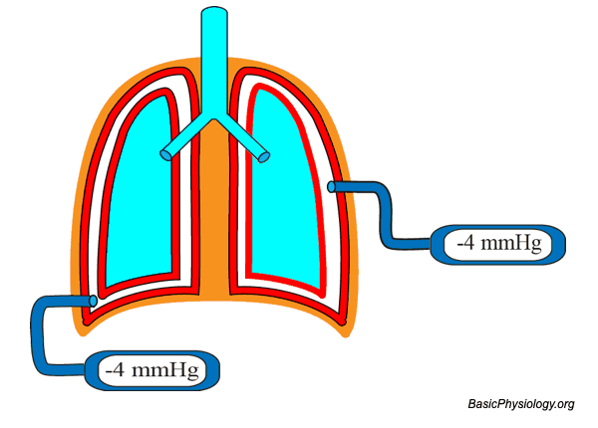
*intrapleural pressure under normal, resting conditions.
Why –4 mmHg matters
Keeps lungs inflated
Prevents lung collapse
Allows lungs to expand when you inhale (pressure becomes even more negative)

Slide 25
Pressure Relationships
If intrapleural pressure becomes positive (e.g., pneumothorax), the lung collapses. A pneumothorax occurs when air enters the pleural space, usually due to trauma (stab wound, fractured rib) or spontaneously (ruptured bleb).

Slide 26
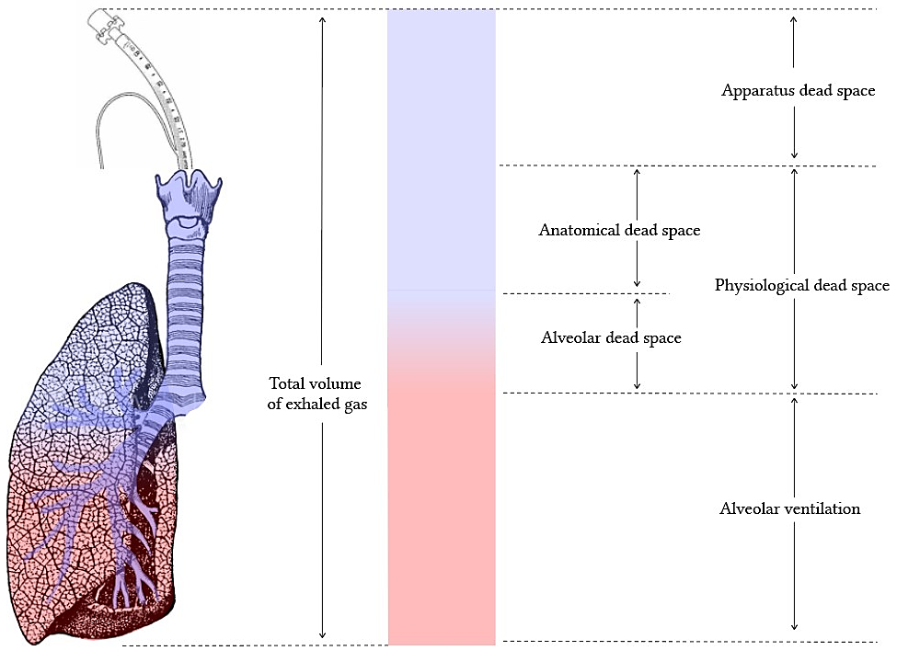
Anatomical Dead Space
The volume of the conducting zone (nose, trachea, bronchi, terminal bronchioles) that does not contain alveoli and therefore does not participate in gas exchange.
Approximately 150 mL in an average adult—roughly 2 mL/kg of ideal body weight.
This value remains relatively constant, regardless of depth of breathing.
Key concept: If tidal volume (TV) is small (e.g., shallow breaths), a large fraction of each breath remains in dead space → wasted ventilation.

Slide 27
Physiological Dead Space
Represents anatomical dead space + alveolar dead space (wasted ventilation).
Alveolar dead space occurs when alveoli are ventilated but not perfused.
*Alveoli receive air, but not blood flow
Classic cause: Pulmonary embolism (PE)—blood flow is interrupted, so ventilated alveoli receive no blood and cannot exchange gases.

Slide 28
Apparatus Dead Space
Referring to the volume of breathing equipment (tubing, valves, masks, mouthpieces, snorkels, ventilator circuits, etc.) that does not participate in gas exchange and adds to the air a person must move with each breath without delivering it to the alveoli.
Apparatus dead space increases the total physiological dead space, meaning more of each breath is wasted and does not reach the alveoli.

Slide 29
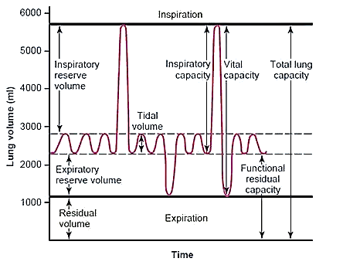
Spirogram

Slide 30
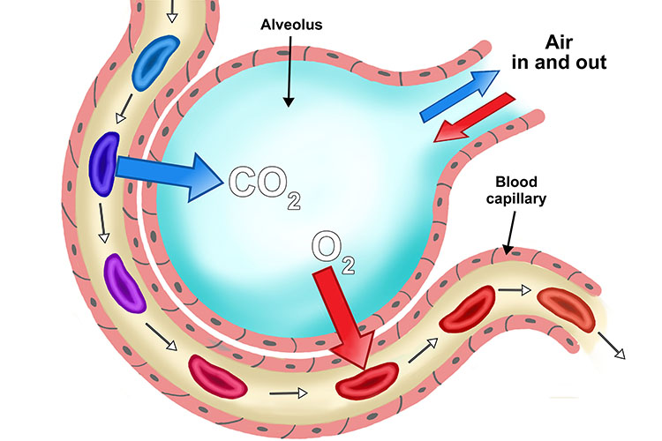
Pulmonary Circulation Basics
The pulmonary vasculature is a high-flow, low-pressure system:
Prevents damage to delicate alveolar membranes
Minimizes edema formation
Blood flow distribution varies with gravity and patient position.
Although both gases diffuse across the same membrane, their behavior differs dramatically:
CO₂ is ~20× more diffusible than O₂
Due to greater solubility in blood and tissues
CO₂ easily crosses membranes even when pathologic changes exist
As a result, hypercapnia (high CO₂) generally occurs later in disease than hypoxemia

Slide 31
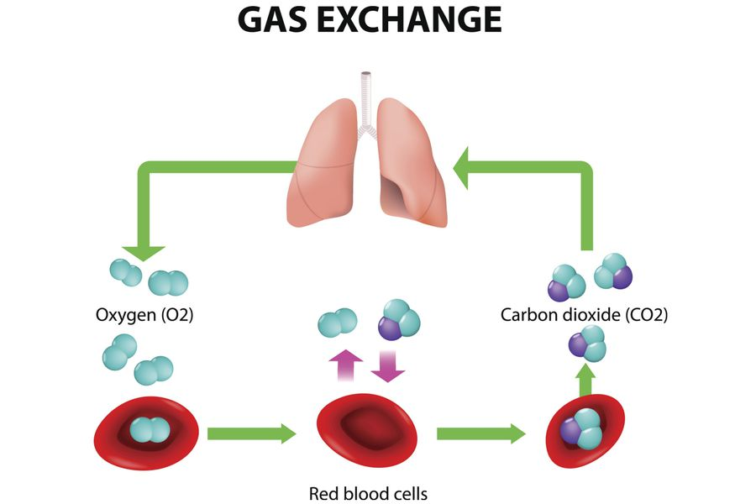
Pulmonary Circulation Basics
O₂ is far more vulnerable to disruption
Oxygen diffusion relies heavily on maintaining a strong pressure gradient and thin membrane
Diseases that alter membrane thickness disproportionately impair O₂ transfer
*A patient may be severely hypoxemic with normal CO₂ levels early in disease—O₂ fails first.

Slide 32
Hemoglobin and Oxygen
Oxygen transport relies overwhelmingly on hemoglobin (Hb) inside red blood cells.
Although oxygen dissolves in plasma, the dissolved fraction is tiny—only 0.3 mL O₂ per 100 mL blood at normal PaO₂ (arterial partial pressure of oxygen).
Human metabolism requires ~250 mL O₂/min, far exceeding what dissolved O₂ can supply.

Slide 33
Hemoglobin and Oxygen
Hemoglobin provides reservoir capacity so oxygen can be carried, stored, and released in proportion to tissue demand.
Each Hb molecule binds 4 O₂ molecules via iron atoms in heme groups—creating a reversible and regulated transport system.
Clinical insight: Anemia reduces oxygen-carrying capacity without altering PaO₂ — meaning the blood appears “normally oxygenated” but cannot deliver adequate oxygen.

Slide 34
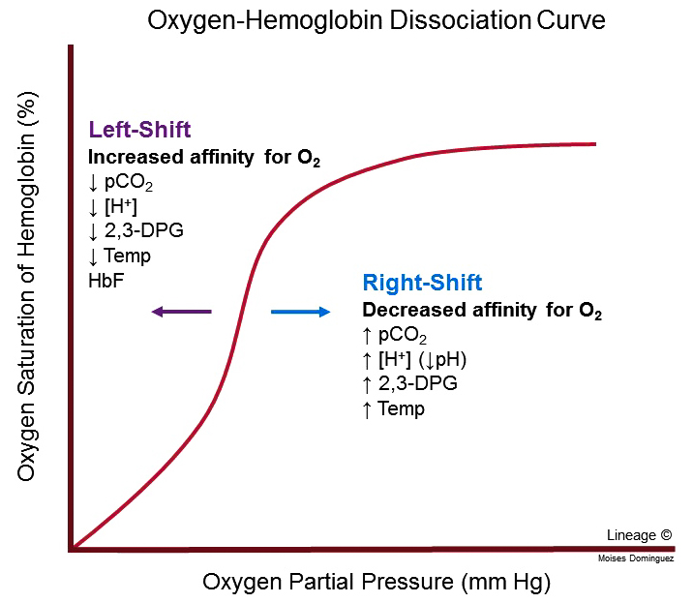
X-axis: Partial pressure of oxygen (PO₂, mmHg) – how much oxygen is available
Y-axis: Percent saturation of hemoglobin – how much oxygen hemoglobin is carrying
*Focus on how pH and temperature shift this graph
*Don’t need to know 2,3 DPG (2,3-Diphosphoglycerate- a molecular found inside RBCs)

Slide 35
Oxyhemoglobin Curve
Sigmoid shape reflects cooperative binding.
P50 indicates affinity of hemoglobin for O₂. P50 = the partial pressure of oxygen (PO₂) at which hemoglobin is 50% saturated with oxygen.
The curve relates PaO₂ (partial pressure of O₂ in blood) to % saturation of Hb.
Its sigmoid shape reflects cooperative binding—binding of one O₂ molecule increases affinity for the next.
Low P50 = high affinity (left shift)
Hypothermia, Hyperventilation, Carbon monoxide poisoning, fetal hemoglobin, anemia, high altitude
High P50 = low affinity (right shift)
Exercise, fever, renal failure, sepsis, pregnancy, hyperthyroidism (Grave’s Disease)
Why this matters: Small shifts dramatically alter oxygen delivery, even if PaO₂ appears normal.

Slide 36
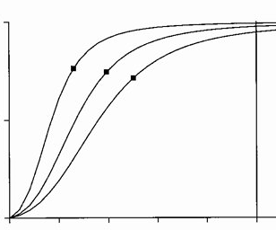
Hypothermia, Hyperventilation, Carbon monoxide poisoning, fetal hemoglobin, anemia, high altitude
X-axis: Partial pressure of oxygen (PO₂, mmHg) – how much oxygen is available
PaO₂
PaO2 is measured by the ABG test (arterial blood gas test)
Y-axis: Percent saturation of hemoglobin – how much oxygen hemoglobin is carrying
SaO₂ / SO₂
Correlates to the oximeter
Shift Left
P50
P50
P50
Oxygen Saturation Hemoglobin:
How much oxygen hemoglobin is carrying
Shift Right
Exercise, fever, renal failure, sepsis, pregnancy, hyperthyroidism (Grave’s Disease)
15
Lower
p50
27
32
Higher
p50
Oxygen partial pressure (mmHg): how much oxygen is available

Slide 37
CO2 Transport

Slide 38
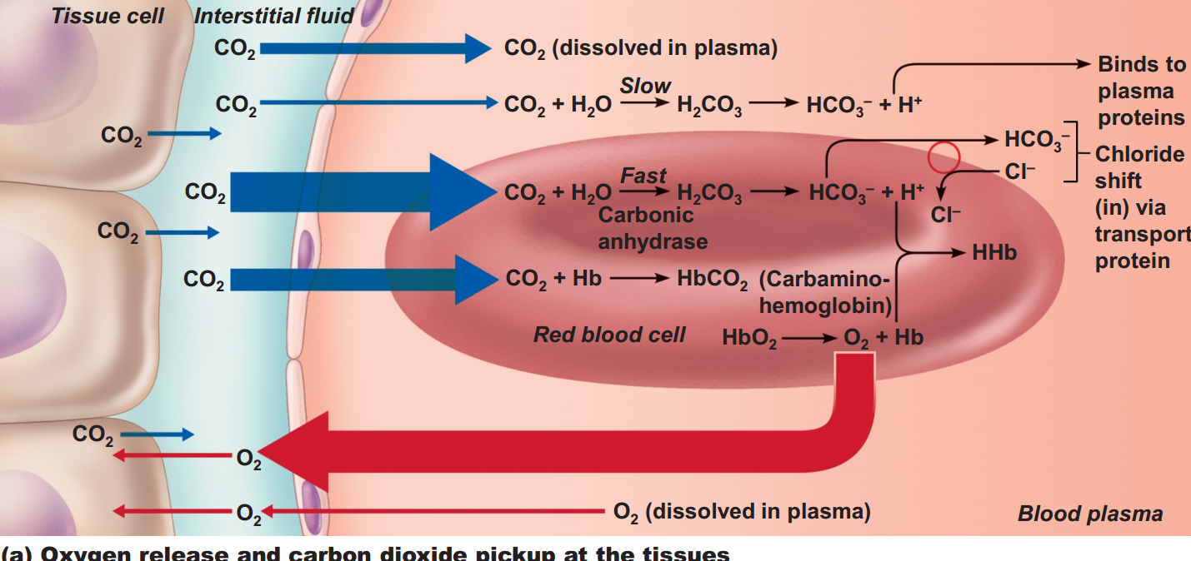
CO2 Trasport
CO₂ is carried safely as bicarbonate in the plasma
bicarbonate transport
CO2 enters RBC
Hb binds Co2
Alveoli type 1 cells
Cl- enters RBC, bicarbonate exits
HHb(reduced hemoglb) (hemoglobin buffers H+ ions)
CO₂ binding helps release O₂ (Bohr effect).
Hemoglobin releases O₂
H₂CO₃ = Carbonic Acid
Notes:
1️⃣ Dissolved in Plasma (~7%)
A small amount of CO₂ simply stays dissolved in the plasma.
2️⃣ Converted to Bicarbonate (HCO₃⁻) (~70%)
This is the major method of CO₂ transport.
Inside red blood cells:
CO₂ + H₂O → H₂CO₃ (carbonic acid)
Catalyzed rapidly by carbonic anhydrase
H₂CO₃ → HCO₃⁻ + H⁺
Bicarbonate (HCO₃⁻) leaves the RBC into the plasma
To maintain electrical neutrality, Cl⁻ enters the RBC ➝ This is called the Chloride Shift
The H⁺ produced binds to hemoglobin (forming HHb, reduced hemoglobin)
Result: CO₂ is carried safely as bicarbonate in the plasma.
3️⃣ Bound to Hemoglobin (~23%)
CO₂ binds directly to hemoglobin to form:
CO₂ + Hb → HbCO₂ (Carbaminohemoglobin)
This is NOT the same binding site as oxygen. Hemoglobin can carry both CO₂ and O₂, but CO₂ binding helps release O₂ (Bohr effect).

Slide 39
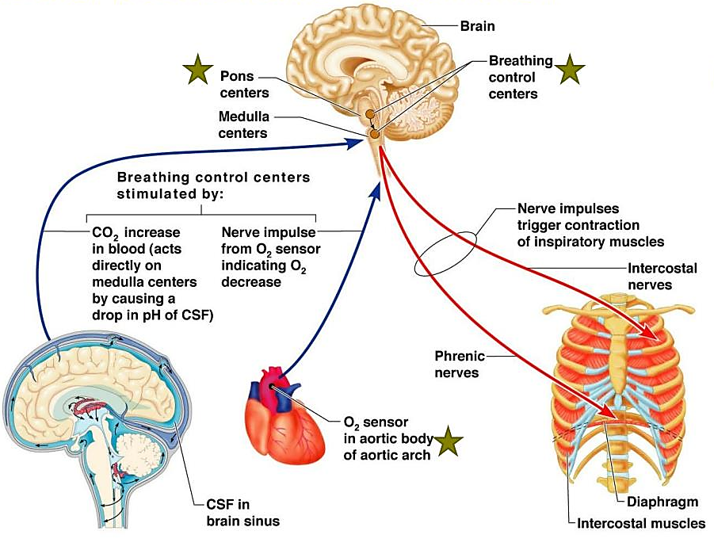
Neural Control Of Breathing
Central Pattern Generator
Located in the medulla and pons
Generates the rhythmic drive for inspiration
*Projects to diaphragm via phrenic nerve (C3–C5)
*Intercostal nerves → intercostal muscles (muscles between the ribs)
Central Chemoreceptors
Located near the medulla, bathing in CSF
Respond primarily to H⁺ generated from CO₂
Most powerful driver of ventilation
Do not respond directly to O₂
Peripheral Chemoreceptors
Located in carotid and aortic bodies
This is different from the baroreceptors

Slide 40
END: Any questions???
Reminders:
Quiz 9/10 due next week
Quiz 11 to be released: This will be on my recorded drawings (topic 25 on preppages.com). The pulmonary drawings are up!
Tomorrows lab:
Lab exam 3 (50 pts)
Scavenger hunt (50 pts)
Exam Review: Re-ask students about dates/times (send zoom link &post it on preppages)
Wednesday (Dec 10) at 5pm???
Final Exam: In our regular scheduled classroom
BIO325: Tuesday (Dec 16) at 9:45am

Slide 41
Thank you!
Thank you for a wonderful first semester!
See you tomorrow!

Slide 43
END: Any questions???
Reminders:
Quiz 9/10 due next week
Quiz 11 to be released: This will be on my recorded drawings (topic 25 on preppages.com). The pulmonary drawings are up!
Tomorrows lab:
Lab exam 3
Scavenger hunt
Exam Review: Re-ask students about dates/times (send zoom link &post it on preppages)
Thursday (Dec 11 at 530pm)???
Final Exam: In our regular scheduled classroom
BIO123: Monday (Dec 15) at 9:45am

