Slide 1
Topic 23: CO and Baroreceptors
Dr. T

Slide 2
EVD

Slide 3
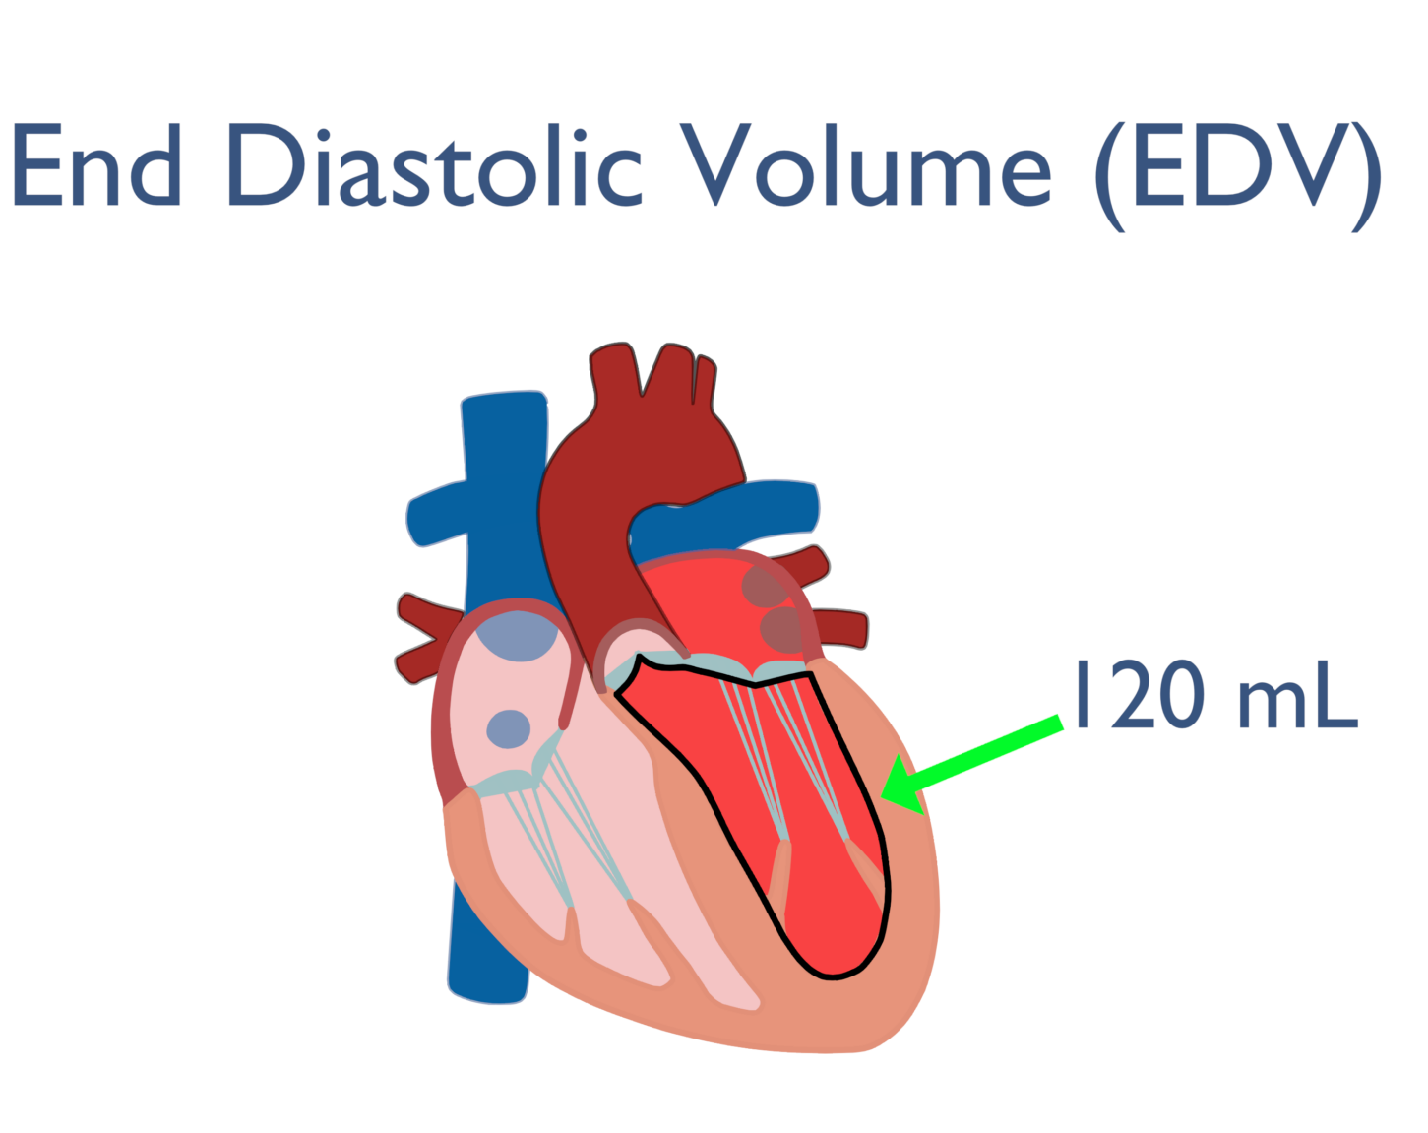
A. Introduction to the Cardiac Cycle 1
End-diastolic volume – total volume of blood in the ventricles at the end of diastole
Relaxation phase
EDV: Maximal volume the ventricle holds before systole
*how much blood can be pumped out with the next heart beat
Notes:
End Diastolic Volume is the amount of blood in the ventricle at the end of diastole, just before the heart contracts.
Diastole = relaxation phase
During diastole, the ventricles fill with blood
EDV represents the maximum volume the ventricle holds before systole (the contraction phase)

Slide 4
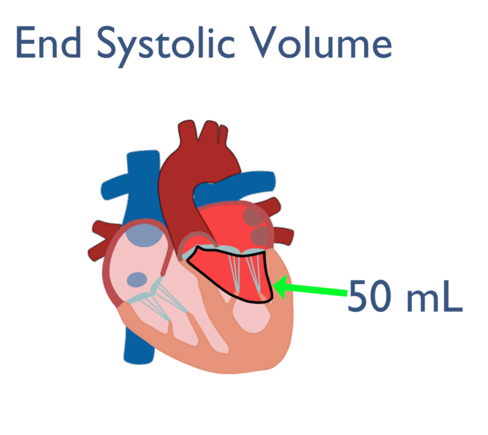
Introduction to the Cardiac Cycle 2
Contraction phase
End-systolic volume – the amount of blood left in the left ventricle after systole (1/3 of the end-diastolic volume)
Stroke Volume: The absolute amount of blood (in mL) ejected by the left ventricle with each beat
At the average cardiac rate of 75 beats/min, each cycle lasts 0.8 sec
ESV: how much blood remaining in the ventricles after it contracts
*what is left behind when the contraction is complete

Slide 5
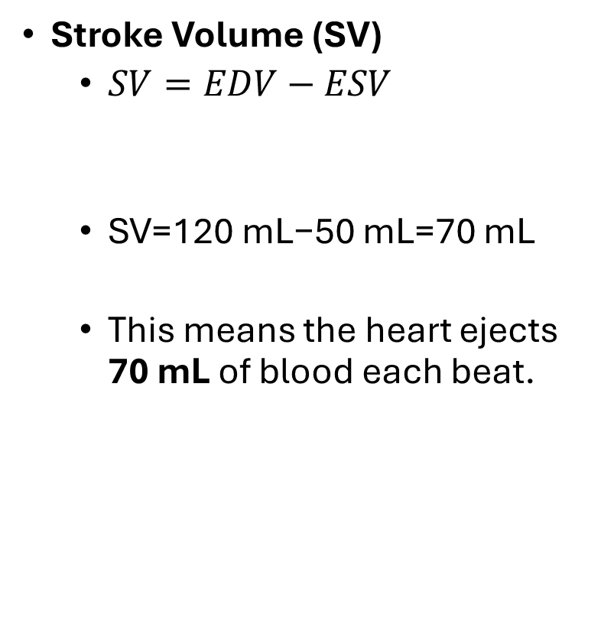
Stroke Volume
Stroke Volume (SV)
$SV=EDV−ESV$
SV=120 mL−50 mL=70 mL
This means the heart ejects 70 mL of blood each beat.
Stroke Volume: The absolute amount of blood (in mL) ejected by the left ventricle with each beat
Ejection Fraction: The % of EDV that is ejected during systole
EF = (SV / EDV) × 100
SV and Ejection Fraction- if on the exam I would give the equations

Slide 6
CO

Slide 7
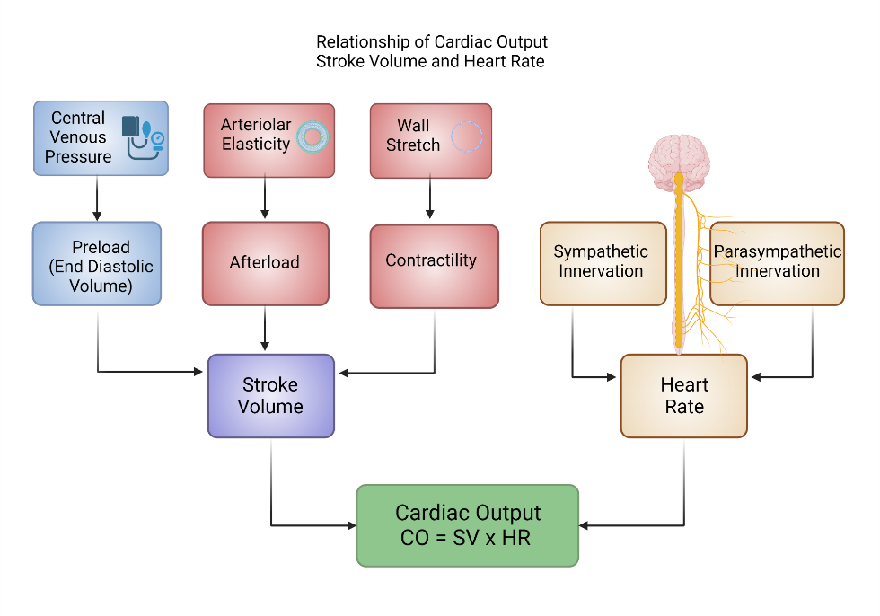
Cardiac Output
Cardiac output is the volume of blood the heart pumps per minute, crucial for assessing heart health and function.
Cardiac Output (CO)=Heart Rate (HR)×Stroke Volume (SV)
Heart Rate (HR): The number of heartbeats per minute.
Stroke Volume (SV): The volume of blood pumped from the left ventricle with each heartbeat.
For a healthy adult at rest, the average cardiac output is about 5 to 6 liters per minute.
This measurement is vital as it reflects the heart's ability to supply oxygen and nutrients to the body's tissues, which is essential for maintaining overall health.

Slide 8
Preload
Preload: Preload = Pressure/volume before the pump
Preload is the degree of stretch in the ventricular muscle fibers at the end of diastole just before contraction.
It reflects venous return and is proportional to end-diastolic volume (EDV)—the more blood entering the heart, the more the ventricles stretch.

Slide 9
Afterload
Afterload: Afterload = After the pump = resistance
Afterload is the resistance the ventricles must overcome to eject blood during systole.
It represents the pressure the heart pumps against—primarily systemic vascular resistance and aortic pressure in the left ventricle.

Slide 10
Contractility
Contractility: Contractility = squeeze power
Contractility is the intrinsic strength of the cardiac muscle independent of preload and afterload.
It reflects how forcefully the heart can contract, influenced by calcium availability, sympathetic stimulation, and catecholamines (e.g., epinephrine).

Slide 11
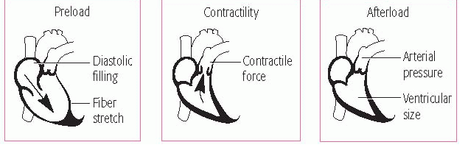
=Stroke Volume: The absolute amount of blood (in mL) ejected by the left ventricle with each beat
The degree of stretch of ventricular muscle fibers at the end of diastole—how much blood fills the ventricle before contraction.
The intrinsic strength of the ventricle’s contraction independent of preload and afterload.
The resistance the ventricle must overcome to eject blood—essentially arterial pressure it pushes against.
*not on study guides

Slide 12
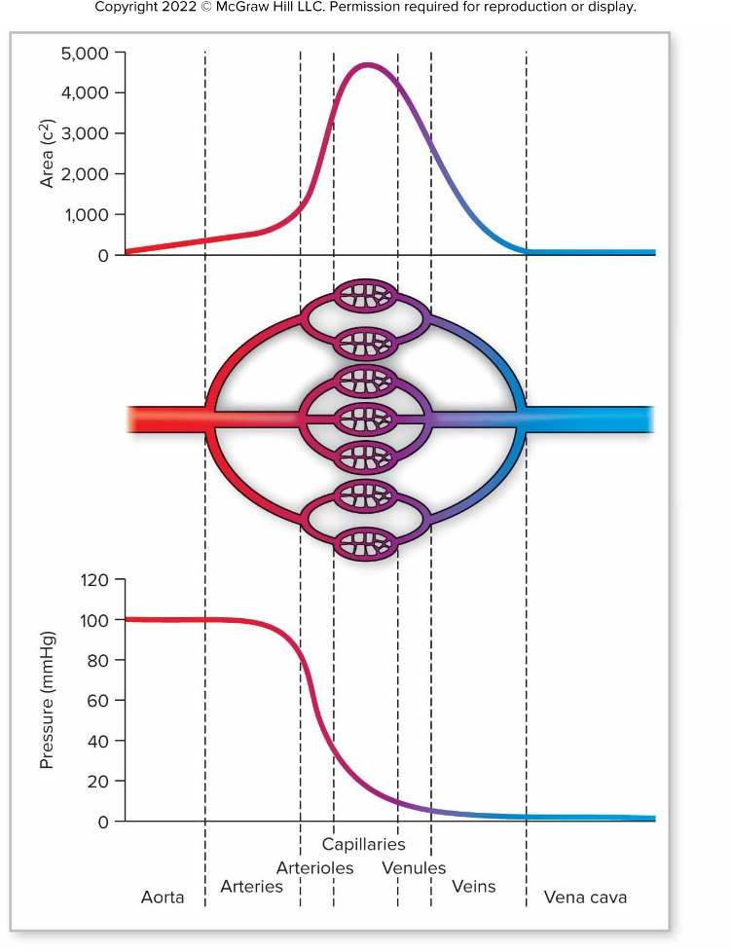
Blood Pressure
Affected by blood volume/stroke volume, total peripheral resistance, and cardiac rate
Increase in any of these will increase blood pressure.
Vasoconstriction of arterioles raises blood pressure upstream in the arteries.
The blood pressure of blood vessels is related to the total cross-sectional area
Capillary blood pressure is low because of large total cross-sectional area.
Artery blood pressure is high because of small total cross-sectional area

Slide 13
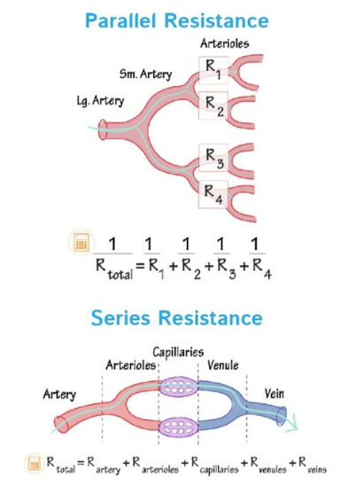
Total Peripheral Resistance (TPR)
*image not for memorization
TPR is the overall resistance to blood flow in the systemic circulation. It reflects how hard the heart must work to push blood through all the blood vessels in the body.
TPR represents the sum of all vascular resistance offered by arterioles, capillaries, and venules in the systemic circuit.
It is mainly determined by arteriolar diameter—the smaller the vessels, the greater the resistance and the harder the heart must pump.
↑ TPR = ↑ Blood Pressure;
↓ TPR = ↓ Blood Pressure
Wide arteriole
Narrow arteriole
Blood Pressure=Cardiac Output×TPR
*Calculation not for memorization

Slide 14
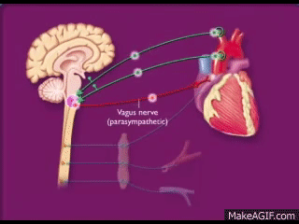
Baroreceptor Reflex
The baroreceptor reflex is one of the body’s fastest and most important mechanisms for moment-to-moment blood pressure regulation. Think of it as your cardiovascular autopilot system that keeps BP stable every time you stand up, get scared, or start running.

Slide 15
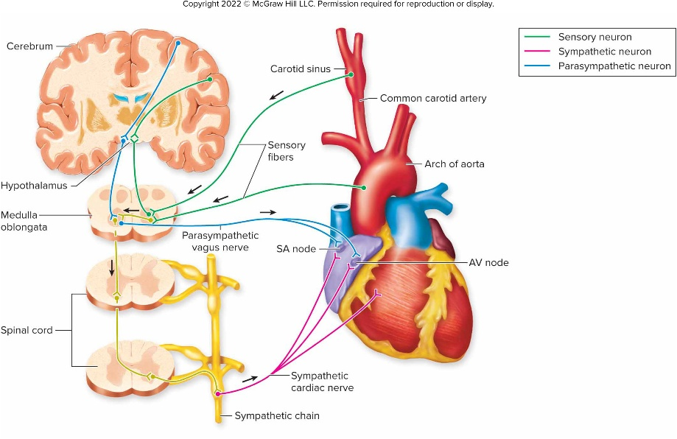
Baroreceptor Reflex
Sensory Detection (Green pathways):
Senses stretch in vessel walls (more stretch= higher BP)
Activated by changes in blood pressure detected by baroreceptors (stretch receptors) in the aortic arch and carotid sinuses
Parasympathetic Response (Blue pathways):
Vagus nerve→
SA node/AV node
Parasympathetic nerves do NOT innervate ventricles—important exam point!
Sympathetic Response (Pink pathways): From the spinal cord →sympathetic chain to the SA node, AV node, Ventricles
*good exam questions here
Notes:
1. Sensory Detection (Green pathways)
Baroreceptors in the:
Carotid sinus (via CN IX – Glossopharyngeal nerve)
Aortic arch (via CN X – Vagus nerve)
sense stretch in the vessel walls → more stretch = higher BP.
These sensory neurons carry information to the medulla oblongata in the brainstem.
2. Processing Center (Medulla Oblongata)
The medulla houses the cardiovascular control center with two key nuclei:
Cardioinhibitory center → parasympathetic output
Cardioacceleratory center → sympathetic output
It integrates the sensory input and decides whether to raise or lower blood pressure.
3. Autonomic Outputs
A. Parasympathetic Response (Blue pathways)
Travels through the Vagus nerve directly to the SA node (and some to the AV node).
Effects:
↓ Heart rate (negative chronotropy)
↓ Conduction speed (negative dromotropy) → Lowers cardiac output and blood pressure
Parasympathetic nerves do NOT innervate ventricles—important exam point!
B. Sympathetic Response (Pink pathways)
From the spinal cord and sympathetic chain to:
SA node and AV node
Ventricular myocardium (→ ↑ contractility)
Blood vessels (→ vasoconstriction)
Effects:
↑ Heart rate (chronotropy)
↑ Contractility (inotropy)
↑ Vasoconstriction (increases TPR) → Raises blood pressure

Slide 16
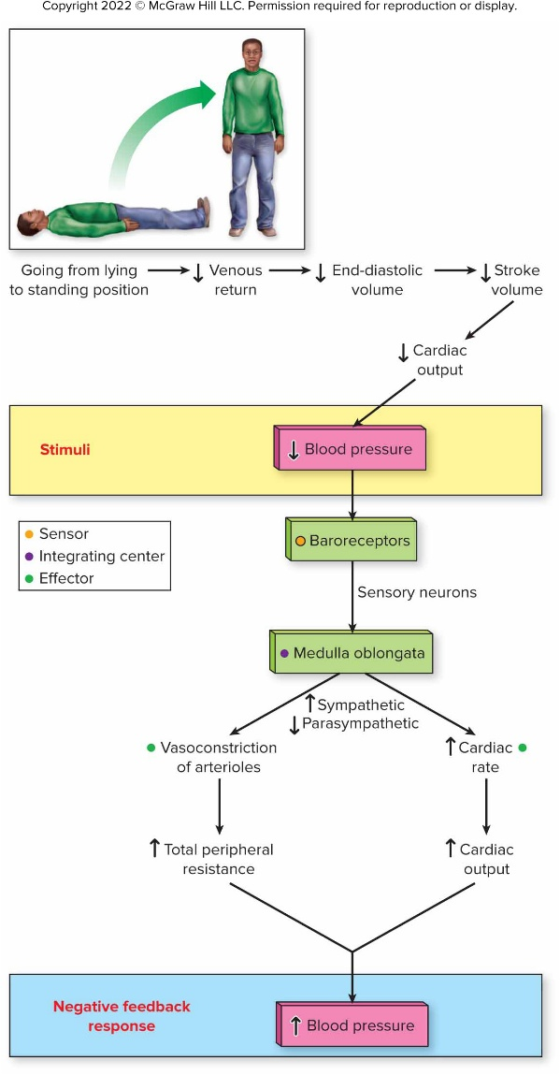
Baroreceptor Reflex
Orthostatic (postural) blood pressure regulation
Stand up (G pulls blood down)
BP=CO X TPR
Drop in BP=dizzy or lightheaded
Baroreceptors detect a ↓ in stretch
→BP is low
Signal → Medulla
Response: increase SNS output
↑↑↑HR → ↑↑↑CO
↑↑↑Vasoconstriction → ↑↑↑ TPR
Increased blood pressure stretches these receptors, increasing action potentials to the vasomotor and cardiac control centers in the medulla.
Most sensitive to drops in blood pressure
The vasomotor center controls vasodilation and constriction to regulate peripheral resistance
The cardiac center controls heart rate.
Structures of the baroreceptor reflex
Aortic arch and carotid sinus baroreceptors
Vasomotor and cardiac control centers in the medulla oblongata
Parasympathetic and sympathetic axons to the heart and blood vessels
HR

Slide 17
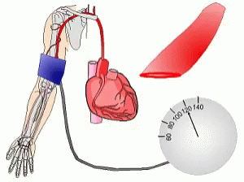
Hypertension
Hypertension is a chronic medical condition characterized by persistently elevated arterial blood pressure above normal physiological levels.
It means the force of blood pushing against the walls of the arteries is consistently too high, which makes the heart work harder to pump blood.
If untreated, it progressively damages blood vessels and major organs, leading to:
Heart disease and heart failure, Stroke, Kidney damage, Vision loss, Atherosclerosis (hardening of arteries)
Nicknamed the "silent killer" because it usually causes no symptoms until severe organ damage occurs.

Slide 18
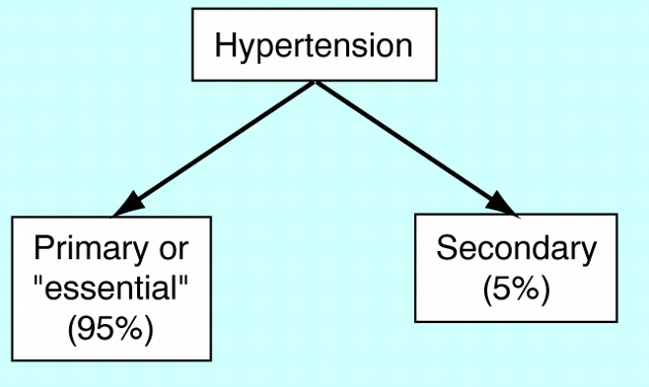
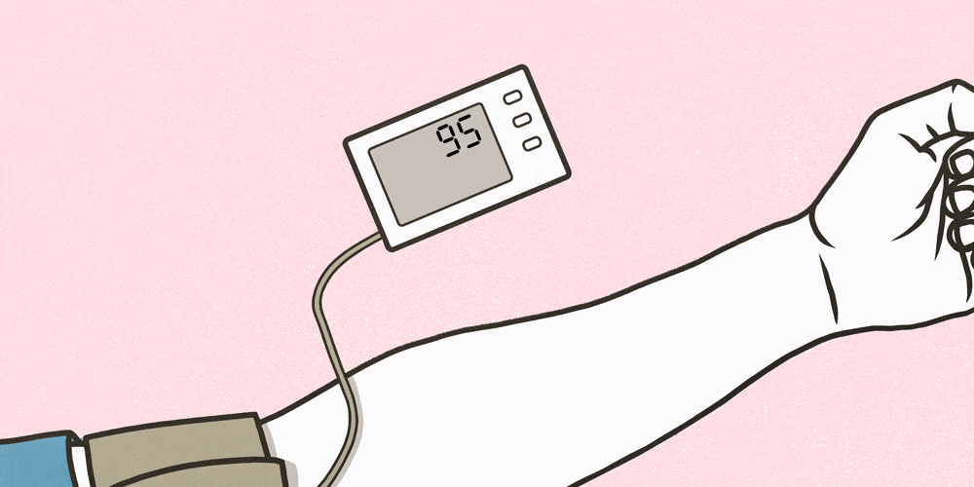
Hypertension
Primary or essential hypertension is a result of complex and poorly understood processes (increased salt intake, increase SNS activity, responses to paracrine regulators, Nitric Oxide decrease, increased TPR/total peripheral resistance)

Slide 19
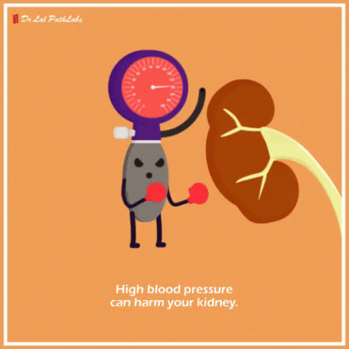
Hypertension
Secondary hypertension is a symptom of another disease, such as kidney disease; accounts for about 5% of all hypertension (kidney disease, renal artery disease, excessive catecholamines or aldosterone, damage to vasomotor center, heart block)

Slide 20
END
Questions?

